Slide 1
ME759 High Performance Computing for Applications in Engineering [Spring 2020]
Lecture 22
03/13/2020
Dan Negrut, 2020 ME759 UW-Madison

Slide 2
The quote the day
“Det er vanskeligt at spaa, især naar det gælder Fremtiden.”
“It is difficult to make predictions, especially about the future.”
-- Danish folklore

Slide 3
Before we get going…
thread
Task generator
Last time:
Discussion of default projects
Tasks, wrap up
Variable scoping issues
Today:
Synchronization issues
Performance issues
NUMA & Cache issues
Other tidbits:
Last lecture with folks in the audience
Not clear yet how I’ll deliver the last 6 lectures
Ideally, I’d keep recording in this same room
ME759 Exam: April 15, at 7:15 PM, in 1106ME
Review: Tu, April 14, at 7:00 PM, in Canvas
Happens fast!
…
thread
thread
thread
Execute tasks

Slide 4
Work Plan, OpenMP
What is OpenMP?
Parallel regions
Work sharing – Parallel tasks
Variable Scoping Issues
Synchronization
Performance issues
Loose ends

Slide 5
The barrier Construct
This is an explicit barrier synchronization
Each thread waits until all threads arrive
Example below assumes that in DoSomework(X,Y) X is an input and Y is the output:
#pragma omp parallel shared(A, B, C)
{
DoSomeWork(A,B); // input is A, output is B
#pragma omp barrier
DoSomeWork(B,C); // input is B, output is C
}
Quick question: how about breaking this into two parallel regions?
[IOMPP]→
Notes:
Quick question: how about breaking this into two parallel regions?
If we break, then you might have to wake up threads again – might be costly. At a barrier, they spin.

Slide 6
Implicit Barriers
Several OpenMP constructs have implicit barriers
parallel – necessary barrier – cannot be removed
for
single
sections
Unnecessary barriers hurt performance and can be removed with the nowait clause
The nowait clause is applicable to:
for directive
single directive
sections directive
[IOMPP]→

Slide 7
The nowait Clause
#pragma omp for nowait
for(…)
{ […] }
#pragma single nowait
{ […] }
Use when threads unnecessarily wait between independent computations
#pragma omp for schedule(static) nowait
for(int i=0; i<n; i++)
a[i] = bigFunc1(i);
#pragma omp for schedule(dynamic,1)
for(int j=0; j<m; j++)
b[j] = bigFunc2(j);
[IOMPP]→

Slide 8
Example, Synchronization Issue: Computing the Dot Product
float dot_prod(float* a, float* b, int N)
{
float sum = 0.0;
#pragma omp parallel for shared(sum)
for(int i=0; i<N; i++) {
sum += a[i] * b[i];
}
return sum;
}
What is wrong here?
[IOMPP]→

Slide 9
Race Condition
Race condition: two or more threads access a shared variable at the same time
Leads to nondeterministic behavior
Both Thread A and Thread B are executing the statement
sum += a[i] * b[i];
[IOMPP]→

Slide 10
Race conditions (data hazards) – two possible scenarios
Value of
sum
Thread A
Thread B
Value of
sum
Thread A
Thread B
11.667
11.667
+3.765
+3.765
15.432
11.667
15.432
15.432
+ 3.563
+ 3.563
18.995
15.230
Order of thread execution causes non-deterministic behavior in a data race
[IOMPP]→

Slide 11
Example: Computing the Dot Product, second attempt
The critical construct: protects access to shared, modifiable data
The critical section allows only one thread to enter it at a given time
float dot_prod(float* a, float* b, int N)
{
float sum = 0.0;
#pragma omp parallel for shared(sum)
for(int i=0; i<N; i++) {
#pragma omp critical
sum += a[i] * b[i];
}
return sum;
}
[IOMPP]→

Slide 12
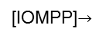
The critical Directive
#pragma omp critical[(name)]: defines a critical region on a structured block
float* RES;
//… more stuff happens here
#pragma omp parallel num_threads(4)
{
#pragma omp for
for(int i=0; i<8; i++) {
float B = job1(i);
#pragma omp critical(RES_lock)
consum(B, RES);
job2(B);
}
}
Threads wait their turn – only one at a time calls consum() thereby preventing race conditions
Naming the critical construct RES_lock is optional but highly recommended
[IOMPP]$→$

Slide 13
OpenMP critical Construct
RES
float* RES;
#pragma omp parallel
{
#pragma omp for num_threads(4)
for(int i=0; i<8; i++) {
float B = job1(i);
#pragma omp critical(RES_lock)
consum(B, RES);
job2(B);
}
}
i=0,1
i=2,3
i=4,5
i=6,7
B=job1
B=job1
B=job1
B=job1
Time: arrow points to future
consum
job2
consum
consum
job2
job2
consum
job2
RES
[IOMPP]$→$

Slide 14
The atomic Directive
Applies only to simple update of memory location
It’s a guarded memory access operation
Also seen in GPU computing
Special case of a critical section
Atomic introduces less overhead than critical
index[0] = 2;
index[1] = 3;
index[2] = 4;
index[3] = 5;
index[4] = 4;
index[5] = 0;
index[6] = 5;
index[7] = 1;
#pragma omp parallel for shared(x, y, index)
for (i = 0; i < n; i++) {
#pragma omp atomic
x[index[i]] += work1(i);
y[i] += work2(i);
}
[IOMPP]→

Slide 15
OpenMP atomic Directive
Unlike a critical directive, the atomic directive:
Can only protect a single assignment
Applies only to simple update of memory
The assignment that can be protected by atomic must be one of: x <op>= <expression>; x++; ++x; x--; --x;
<op> can be one of: +, *, -, /, &, ^, |, <<, >>
<expression> must not reference x
Only the load and store of x is protected (not <expression>)

Slide 16
Synchronisation is costly. Avoid if possible.
Barriers can be very expensive
Typically 1000s cycles to synchronise
Recall that you have explicit and implicit barriers
Avoid barriers via:
Careful use of the nowait clause
Parallelize at the outermost level possible
May require re-ordering of loops / indexes
Use critical or atomic. Yet this may impact performance too

Slide 17
The reduction Construct
#pragma omp parallel for reduction(+:sum)
for(i=0; i<N; i++) {
sum += a[i] * b[i];
}
Local copy of sum for each thread engaged in the reduction is private
Each local sum initialized to the identity operand associated with the operator that comes into play
Here we have “+”, so it’s a zero (0)
All local copies of sum added together and stored in “global” variable
[IOMPP]→

Slide 18
The reduction Clause
#pragma omp for reduction(op:list)
The variables in list will be shared in the enclosing parallel region
Here’s what happens inside the parallel or work-sharing construct:
A private copy of each list variable is created and initialized depending on the “op”
These copies are updated locally by threads
At end of construct, local copies are combined through “op” into a single value
[IOMPP]→

Slide 19
C/C++ reduction Operations
A range of associative operands can be used with reduction
Initial values are the ones that make sense mathematically
Operand | Initial value | Notes
+ | 0
* | 1
- | 0
& | ~0 | Bitwise AND
| | 0 | Bitwise OR
^ | 0 | Bitwise XOR
&& | 1 | Logical AND
|| | 0 | Logical OR

Slide 20
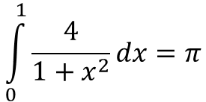
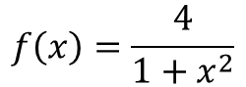
reduction Example: Numerical Integration
static long num_steps=100000;
double step, pi;
void main() {
int i;
double x, sum = 0.0;
step = 1.0/num_steps;
for (i=0; i< num_steps; i++) {
x = (i+0.5)*step;
sum = sum + 4.0/(1.0 + x*x);
}
pi = step * sum;
printf("Pi = %f\n",pi);
}
4.0
$$\int_{0}^{1}{\frac{4}{1+x^{2}}dx=π}$$
$$f\left(x\right)=\frac{4}{1+x^{2}}$$
2.0
0.0
X
1.0
[IOMPP]→

Slide 21
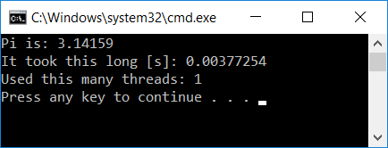
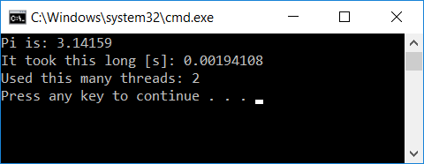
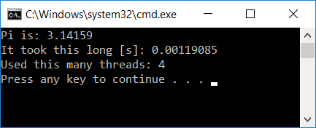
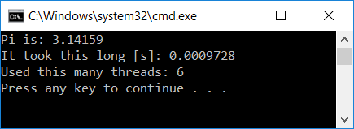
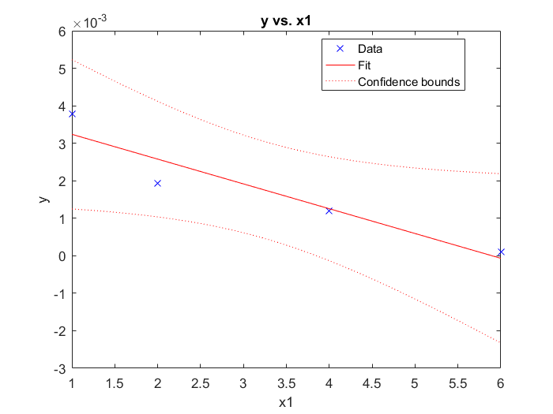
Scaling Analysis: Computation of $π$
#include <omp.h>
#include <stdio.h>
void main() {
static long num_steps = 1000000;
const double step = 1.0 / (double)num_steps;
double sum = 0.0;
double startT = omp_get_wtime();
const int nThreadsUsed = 1;
#pragma omp parallel num_threads(nThreadsUsed)
{
#pragma omp for reduction(+:sum)
for (int i = 0; i < num_steps; i++) {
double x = (i + 0.5)*step;
double dummy = 1. / (1. + x*x);
sum += dummy;
}
}
double myPi = 4.*step * sum;
double timeElapsed = omp_get_wtime() - startT;
printf("Pi is: %f\n", myPi);
printf("It took this long [s]: %f\n", timeElapsed);
printf("Used this many threads: %d\n", nThreadsUsed);
}

Slide 22
Wait, it can get even better: the simd directive
#include <omp.h>
#include <stdio.h>
#include <sys/time.h>
int main() {
int num_steps = 1000000;
const double step = 1.0 / (double)num_steps;
double sum = 0.0;
const int nThreadsUsed = 4;
timeval start, end;
gettimeofday(&start, NULL);
#pragma omp parallel num_threads(nThreadsUsed)
{
#pragma omp for simd reduction(+:sum)
for (int i = 0; i < num_steps; i++) {
double x = (i + 0.5) * step;
double dummy = 1. / (1. + x * x);
sum += dummy;
}
}
double myPi = 4. * step * sum;
gettimeofday(&end, NULL);
int time_used = 1000000 * (end.tv_sec - start.tv_sec) + (end.tv_usec - start.tv_usec);
printf("Pi is: %f\n", myPi);
printf("It took this long [s]: %d\n", time_used);
printf("Used this many threads: %d\n", nThreadsUsed);
return 0;
}
Might be bonus problem on next assignment (if we figure out compiler issues)

Slide 23
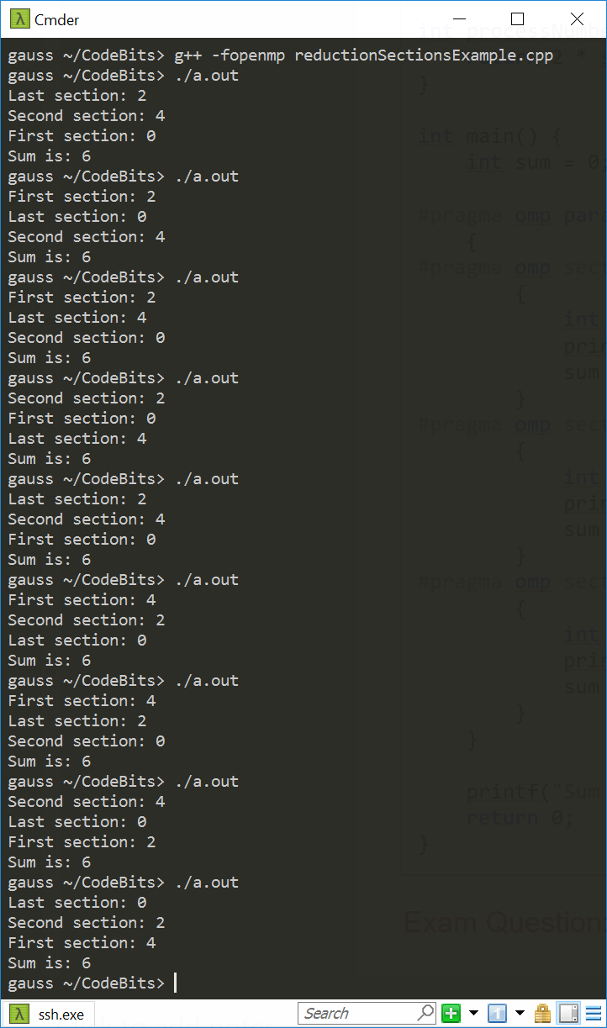
OpenMP reduction Works Beyond for Loops [1/2]
#include <stdio.h>
#include <omp.h>
int processNumber(int someNumber) {
return 2 * someNumber;
}
int main() {
int sum = 0;
#pragma omp parallel sections num_threads(3) reduction(+:sum)
{
#pragma omp section
{
int someVal = processNumber(omp_get_thread_num());
printf("First section: %d\n", someVal);
sum += someVal;
}
#pragma omp section
{
int someOtherVal = processNumber(omp_get_thread_num());
printf("Second section: %d\n", someOtherVal);
sum += someOtherVal;
}
#pragma omp section
{
int dummy = processNumber(omp_get_thread_num());
printf("Last section: %d\n", dummy);
sum += dummy;
}
}
printf("Sum is: %d\n", sum);
return 0;
}
NOTE: sum is always the same. What’s called “First section” is not necessarily executed by thread with smallest id.

Slide 24
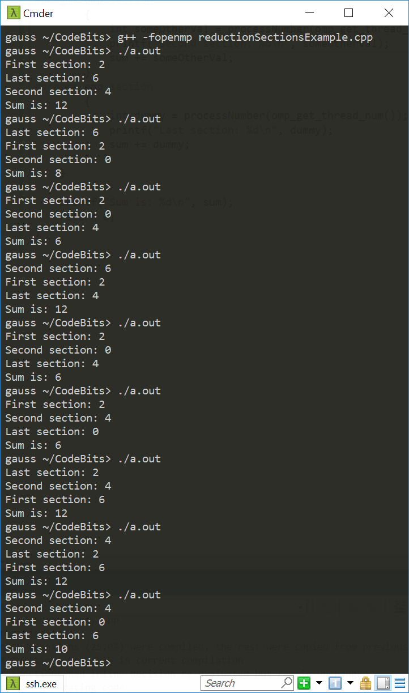
OpenMP reduction Works Beyond for Loops [2/2]
#include <stdio.h>
#include <omp.h>
int processNumber(int someNumber) {
return 2 * someNumber;
}
int main() {
int sum = 0;
#pragma omp parallel sections num_threads(4) reduction(+:sum)
{
#pragma omp section
{
int someVal = processNumber(omp_get_thread_num());
printf("First section: %d\n", someVal);
sum += someVal;
}
#pragma omp section
{
int someOtherVal = processNumber(omp_get_thread_num());
printf("Second section: %d\n", someOtherVal);
sum += someOtherVal;
}
#pragma omp section
{
int dummy = processNumber(omp_get_thread_num());
printf("Last section: %d\n", dummy);
sum += dummy;
}
}
printf("Sum is: %d\n", sum);
return 0;
}
Quiz: Why different sum values when we run this code?

Slide 25
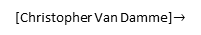
A Histogram Example [more advanced, uses reduction w/ C++ STL]
int main(int argc, char *argv[]) {
// Set number of threads
const auto num_threads = std::atoi(argv[1]);
omp_set_num_threads(num_threads);
// Read in Image
FILE *fid = std::fopen("picture.inp", "r");
int d1 = 1800;
int d2 = 1200;
int len = d1 * d2;
std::vector<int> *image = read_image(fid, d1, d2);
// Histogram Counter
std::vector<int> histCounter = std::vector<int>(7);
std::fill(histCounter.begin(), histCounter.end(), 0);
// Declaration of the std::vector addition
#pragma omp declare reduction(vec_int_add : std::vector<int> : \
std::transform(omp_out.begin(), omp_out.end(), omp_in.begin(), omp_out.begin(), std::plus<int>())) \
initializer(omp_priv = omp_orig)
double startTime = omp_get_wtime(); // Start Clock
#pragma omp parallel for reduction(vec_int_add : histCounter)
// Perfrom the histrogram; shared(histCounter)
for (int jj = 0; jj < len; jj++)
(histCounter)[(*image)[jj]]++;
double endTime = omp_get_wtime(); // Stop Clock
// Ouput information
for (int ii = 0; ii < 7; ii++)
std::cout << (histCounter)[ii] << std::endl;
std::cout << num_threads << std::endl;
std::cout << std::setprecision(16) << (endTime - startTime) * 1000 << std::endl;
// delete(histCounter);
delete (image);
return 0;
}
#include <omp.h>
#include <algorithm>
#include <cmath>
#include <iomanip>
#include <iostream>
#include <vector>
// Read in vector of pixel vales
std::vector<int> *read_image(FILE *fp, int d1, int d2) {
int xVal;
int len = d1 * d2;
std::vector<int> *x = new std::vector<int>(len);
for (int i = 0; i < len; i++) {
fscanf(fp, "%d ", &xVal);
(*x)[i] = xVal;
}
return x;
}
[Christopher Van Damme]$→$

Slide 26
Work Plan, OpenMP
What is OpenMP?
Parallel regions
Work sharing – Parallel tasks
Variable Scoping Issues
Synchronization
Performance issues
Loose ends

Slide 27
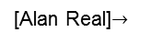
Performance
Easy to write OpenMP code. Not necessarily easy to write efficient OpenMP code
More common causes for performance not being what you hoped it could be
Too much sequential code in your app
Too much communication
Load imbalance
Synchronization
Compiler (non-)optimization
[Alan Real]$→$

Slide 28
Too much sequential code in your app
Beware of Amdahl’s law
If your algorithm/solution is sequential in nature, maybe it’s time to change it
Thinking within the context of OpenMP
All code outside of parallel regions is sequential
In fact, even if in parallel region, code might not run in parallel – recall the master, single and critical directives)
Bottom line:
Seek to reduce amount of execution time where only one thread executes code
[Alan Real]→

Slide 29
Too much communication [that you fail to notice]
On shared memory machines, OpenMP can lead to heavy duty memory operations
Memory accesses are expensive (unless cached)
~100 cycles for a main memory access compared to 1-3 cycles for a flop
Unlike the message passing model (discussed later, for MPI), communication is spread throughout the program
Hard to analyse and monitor; transparent to user, hard to pin down
When you look at your code you should understand where the data that you manipulate comes from
[Alan Real]→

Slide 30
Load Imbalance
Load imbalance: one thread gets too much work, while the others idle waiting for it
Can arise from both communication and computation
Happen most often in conjunction with for loops; worth experimenting with different scheduling options
Can use schedule(runtime)
Helps with experimentation, no need to recompile
Example: setenv OMP_SCHEDULE “dynamic,5”
If no available scheduling appropriate, contemplate taking the load balancing problem in your hands
[Alan Real]→

Slide 31
Synchronisation
Barriers can be very expensive
Typically 1000s cycles to synchronise
Avoid barriers via:
Careful use of the nowait clause
Parallelize at the outermost level possible
May require re-ordering of loops +/ indexes
Use of critical / atomic routines may impact performance
[Alan Real]→

Slide 32
Quiz: Parallelization of the outer loop & synchronization???
How come parallelization of outer loop (instead of inner loop) will be more advantageous given OpenMP implicit synchronization at end of parallel region?
NOTE: code at right goes one step further and collapse two loops into one
There is no “outer loop” anymore
You must make sure there is no data dependencies when you ask for this collapse
#pragma omp parallel for
for (int i = 0; i < N; i++)
{
for (int j = 0; j < M; j++)
{
//do something here, based on i and j.
}
}
#pragma omp parallel for collapse(2)
for (int i = 0; i < N; i++)
{
for (int j = 0; j < M; j++)
{
//do something here, based on i and j.
//must have no data dependency
}
}

Slide 33
Compiler (non)-optimization
Sometimes the addition of parallel directives can prevent the compiler from performing sequential optimization
Symptoms:
Parallel code running with 1 thread has longer execution and higher instruction count than sequential code
Sometimes, it really helps to make shared data private and local to a function
[Alan Real]→

Slide 34
Attractive Features of OpenMP
Parallelize small parts of application, one at a time (beginning with most time-critical parts)
Can implement complex algorithms
Code size grows only modestly
Expression of parallelism flows clearly, code is easy to read
[Rebecca Hartman-Baker]→

Slide 35
Further Reading, OpenMP
Michael Quinn (2003) Parallel Programming in C with MPI and OpenMP
Chapman, Barbara, Gabrielle Jost, and Ruud van der Pas. (2008) Using OpenMP, Cambridge, MA: MIT Press.
Kendall, Ricky A. (2007) Threads R Us, http://www.nccs.gov/wp-content/training/scaling_workshop_pdfs/threadsRus.pdf
Mattson, Tim, and Larry Meadows (2008) SC08 OpenMP “Hands-On” Tutorial, http://openmp.org/mp-documents/omp-hands-on-SC08.pdf
LLNL OpenMP Tutorial, https://computing.llnl.gov/tutorials/openMP/
OpenMP.org, http://openmp.org/
OpenMP 5.0 API Syntax Reference Guide – very nice one-stop shopping:
https://www.openmp.org/wp-content/uploads/OpenMPRef-5.0-111802-print.pdf

Slide 36
Work Plan, OpenMP
What is OpenMP?
Parallel regions
Work sharing – Parallel tasks
Variable Scoping Issues
Synchronization
Performance issues
Loose ends

Slide 37
Loose ends: topics discussed
Non-uniform memory access (NUMA) issues
Cache issues

Slide 38
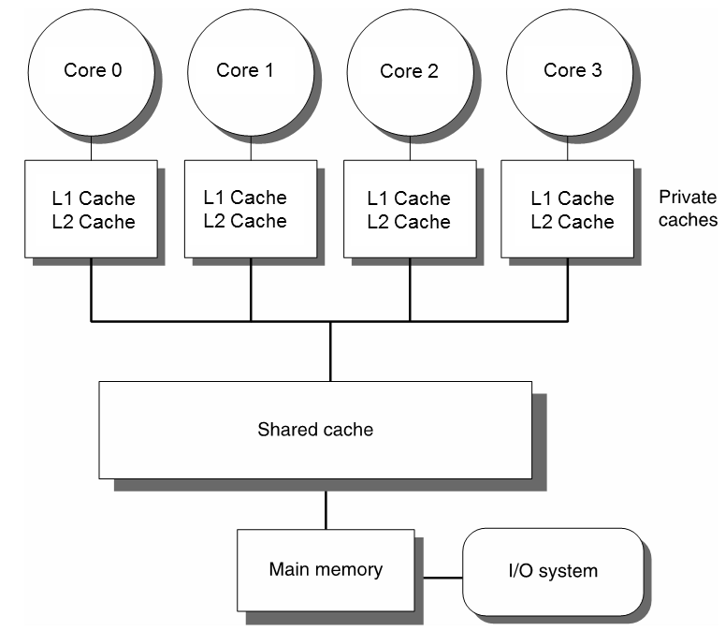
Preamble: the SMP model
Up to this point, not concerned with the mechanics of a shared memory access
Model embraced when discussing OpenMP thus far: SMP
Symmetric Multi-Processor model
All threads/cores have similar overhead to accessing the main memory
SMP model works well for one-chip, four core systems

Slide 39
SMP: not a good model, for today’s high-end hardware
Today’s server/cluster power nodes have many CPUs, each with many cores
“multi-socket configurations”
SMP model doesn’t quite apply
Not all memory accesses are equal (loss of “symmetry”)
A certain core has access time to certain system memory smaller than or equal to any other core on the node
Side note (nomenclature issue):
server node: used a lot by Amazon and Facebook for database manipulations
cluster node: mostly used by Oak Ridge or Argonne National Lab in their supercomputers

Slide 40
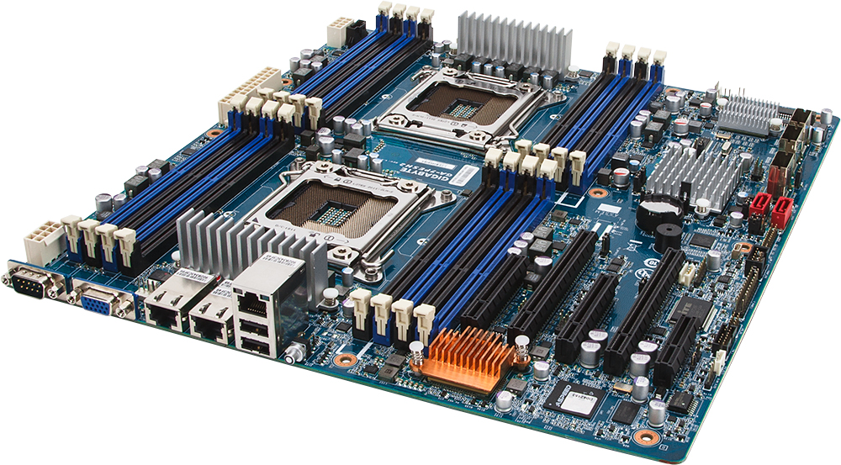
Multi-Socket Configurations [1/2] [two sockets, in this case]
Memory native to socket 0
Memory native to socket 0
Socket-0 for CPU-0
Memory native to socket 1
Socket-1 for CPU-1
Memory native to socket 1
[credit]

Slide 41
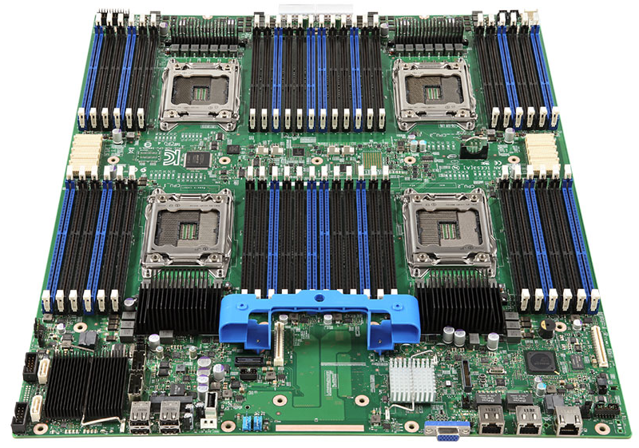
Multi-Socket Configurations [2/2] [four sockets: Intel S4600LT2 Xeon E5-4600 Chipset-C600-A Socket-R LGA-2011 1.46Tb DDR3-1600MHz Server Motherboard]
: Memory Bank
: CPU Socket
[credit]

Slide 42
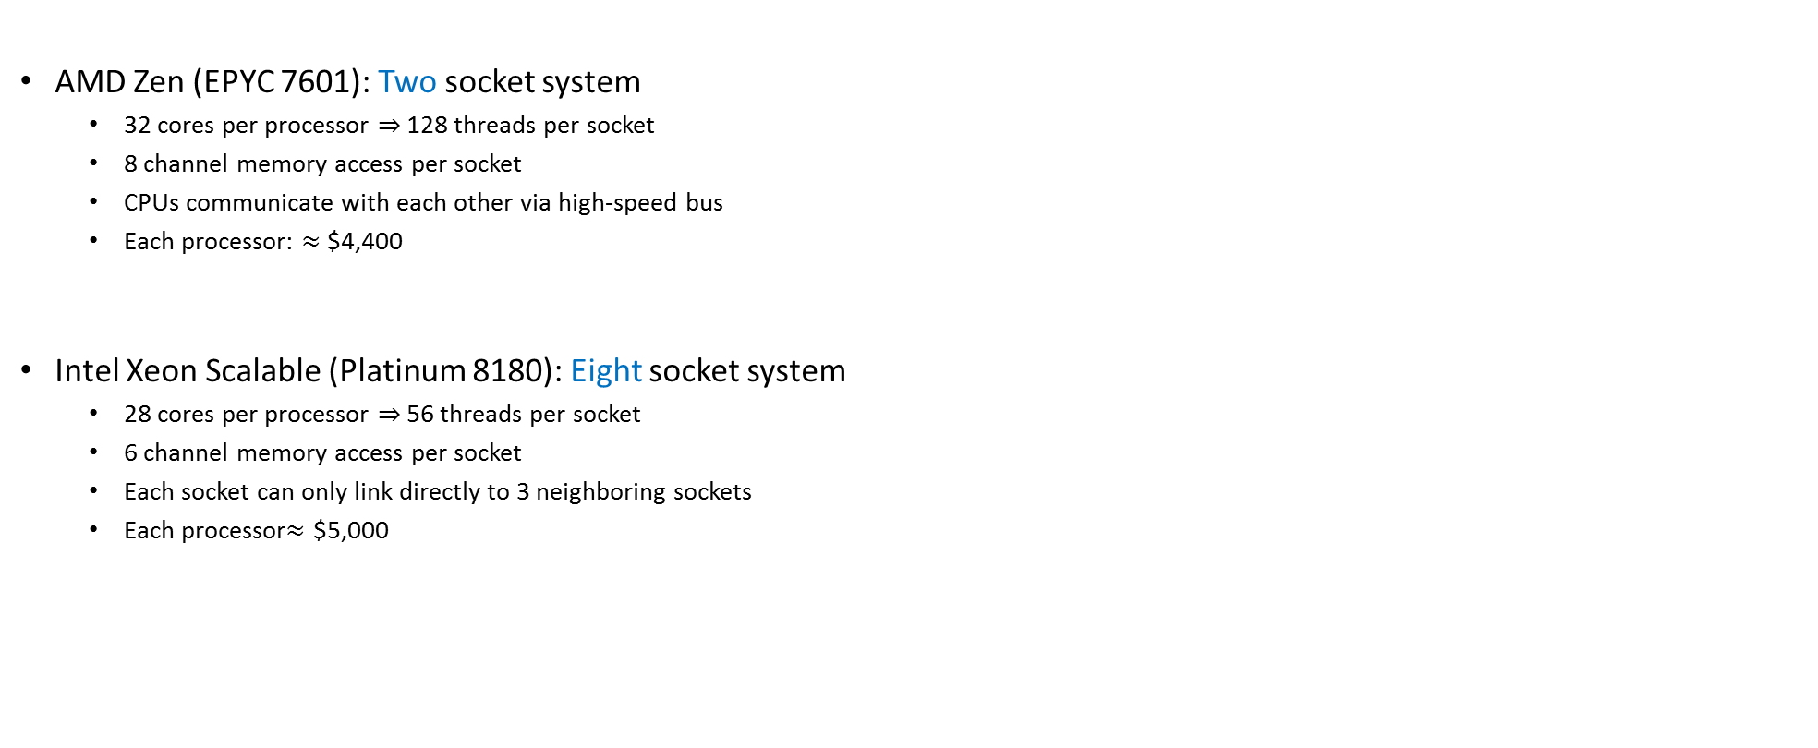
Examples, Recent Layouts
AMD Zen (EPYC 7601): Two socket system
32 cores per processor $⇒$ 128 threads per socket
8 channel memory access per socket
CPUs communicate with each other via high-speed bus
Each processor: $≈$ $4,400
Intel Xeon Scalable (Platinum 8180): Eight socket system
28 cores per processor $⇒$ 56 threads per socket
6 channel memory access per socket
Each socket can only link directly to 3 neighboring sockets
Each processor$≈$ $5,000

Slide 43
Hardware Evolution: CPU count & Memory Access Solutions [Intel Specific]
Ca. 2005: RAM access streamed through Northbridge, unique Memory Controller.
* Poor scalability
Ca. 2008: RAM access streamed through Northbridge but multiple mem banks.
* Poor yet faster mem access
Ca. 2013: Northbridge integrated into CPU. Multiple mem banks.
* Fast mem access to local mem bank
[ Ulrich Drepper: What Every Programmer Should Know About Memory ]→

Slide 44
Non-uniform memory access (NUMA)
NUMA punchline: cost of memory access depends on which memory bank stores your data
Example:
Assume four memory banks: RAM_1, RAM_2, RAM_3, RAM_4
Assume four CPU sockets: CPU_A, CPU_B, CPU_C, CPU_D
RAM_1 bank acts as “native memory” for CPU_A, …, RAM_4 bank acts as “native memory” for CPU_D
Remarks:
Certainly, any CPU can access any memory bank
Thread running on a core of CPU_A will take less time to access data stored in bank RAM_1 than in RAM_3

Slide 45
The NUMA Factor
The ratio between the largest and shortest *average* amount of time for a thread running on a particular core to reach data in memory
Facts, related to the NUMA factor
A low NUMA factor is desirable, it suggests not much of a difference which bank data is stored
A high NUMA encountered in expensive hardware solutions that have hundreds to thousands of CPUs yet they have a *shared* memory layout
SGI’s Altix back in the day
Less common today
NOTE: A system w/ NUMA factor = 1 is an SMP system

Slide 46
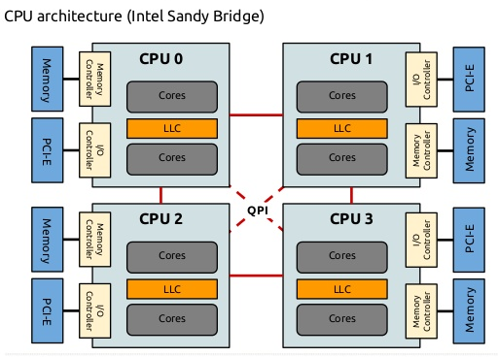
NUMA – A Schematic [Intel specific]
Image below shows a motherboard w/ four sockets
LLC: last level cache (these days, most often it is L3 cache)
QPI: QuickPath Interconnect (more later; also, replaced by Ultra Path Interconnect more recently (Xeon Skylake, 2017))

Slide 47
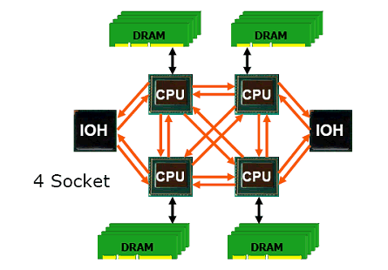
“NUMA Node”
Framing the discussion:
Focus on the case of *one* motherboard that
Hosts multiple sockets/multiple cores
Hosts multiple mem banks
This is the commodity hardware of today
NUMA node
Processors and memory bank next to it
Combines to look much like a small SMP system in its own right
Notation: IOH – Input/Output Hub
NUMA node
[ Dr. Dobb’s ]→

Slide 48
Multi-Socket Configurations [1/2] [two sockets, in this case]
Memory native to socket 0
Memory native to socket 0
Socket-0 for CPU-0
Memory native to socket 1
NUMA Node
Socket-1 for CPU-1
Memory native to socket 1
[credit]

Slide 49
Point-to-Point Technologies: a “local network” between nodes
Each CPU can access data stored in a different NUMA node
Happens over a very fast interconnect, which is like a local network
AMD’s solution name: Hyper Transport (HT)
Intel’s solution name: QuickPath Interconnect (QPI) (more recently: Ultra Path Interconnect (UPI))
The fast interconnect (local network): shown in orange in picture
Possible topologies associated with this “local network”:
2D-torus
2D-lattice (only moves in x or y direction – like 2D grid)
3D-Hypercube (3D version of lattice)
Etc.
NUMA node
[ Dr. Dobb’s ]→

Slide 50
NUMA Performance Hit, order of magnitude
What sort of slowdown should one expect if accessing memory outside a NUMA node?
Approximate values:
20% slowdown for reads
30% slowdown for writes
Values above depend on the number of hops required to reach memory bank
Closer NUMA nodes lead to lower values
[ Ulrich Drepper: What Every Programmer Should Know About Memory ]→

Slide 51
NUMA aspects: How the OS Comes into play
NUMA aspects where Operating System (OS) comes into play
1) When a thread mallocs memory, ideally it should be physically located in same NUMA node.
Footnote: typically the OS can allow different strategies for memory allocation. “Striping the memory” is such a strategy – memory is allocated on all banks. An averaging takes place, in the end you know that it’s not ideal, but on average is ok (particularly for small NUMA factors).
Related concept: data affinity – you want a core to keep operating on the same set of data to maintain locality (hit the cache)
2) Migrating the execution of a thread from one NUMA node to a different one should be avoided if possible.
The OS has a role to play in 1) and 2) above

Slide 52
Data affinity: Preamble/Backdrop
Imagine the following scenario, when executing an OpenMP program
The execution hits parallel for, with static schedule
Assume Master gets Core 0, Thread 1 gets Core 1, …, Thread 15 gets Core 15
Note: Worker threads folded back at end of parallel for
Next, after worker threads folded back, Master thread goes through a sequential segment of the code
Meanwhile, Core 2 has data in its cache that just sits there
Next yet, the execution hits a second parallel for, which this time has a schedule “dynamic”
A thread will be associated with Core 2. But this thread gets assigned to work on data that is in Core 7’s cache
Can be worse: thread on Core 2 needs to access data from a different NUMA node

Slide 53
Data Affinity
Data affinity:
Thread and data processed by thread belong to same NUMA node
It is desirable to have good data affinity; you can asked in your code this
Good when the same core accesses the same subset of program data (for as long as possible)
Why good?
Data is cached on the processor[s] accessing it
Must reuse cached data as much as possible
Try to make these subsets large, contiguous chunks of data
Will avoid false sharing and also NUMA problems (see next slide)

Slide 54
cc-NUMA & Affinity
cc-NUMA: cache-coherent NUMA
Name is self-explanatory
Most likely associated with a directory-based cache coherence
There are two reasons why affinity is good
First: we avoid remote data access; i.e., local network hops, which are costly
Second: overhead of cache-coherence mechanism starts kicking in
Lack of affinity in multi-threaded execution (OpenMP):
A small amount of data out of a big chunk of data that is physically next to CPU0 can get stored in cache of CPU3 as well
Changes made by CPU3 are going to invalidate cache of CPU0; this can’t be good news…

Slide 55
Loose ends: topics discussed
Non-uniform memory access (NUMA)
Cache issues

Slide 56
The Memory Hierarchy
[Bryant and O‘Hallaron:
Computer Systems - A Programmer's Perspective 3rd edition] →
L0:
Regs
CPU registers hold words retrieved from the L1 cache.
Smaller,
faster,
and
costlier
(per byte)
storage
devices
L1:
L1 cache
(SRAM)
L1 cache holds cache lines retrieved from the L2 cache.
L2:
L2 cache
(SRAM)
L2 cache holds cache lines
retrieved from L3 cache
L3:
L3 cache
(SRAM)
L3 cache holds cache lines
retrieved from main memory.
Larger,
slower,
and
cheaper
(per byte)
storage
devices
L4:
Main memory
(DRAM)
Main memory holds disk blocks retrieved from local disks.
L5:
Local secondary storage
(local disks)
Local disks hold files retrieved from disks
on remote servers
L6:
Remote secondary storage
(e.g., web servers, file servers)

Slide 57
Cache Memories [old slide]
Cache memories: small, fast SRAM-based memories managed transparently
Purpose: Hold frequently accessed blocks of main memory
When very useful: when execution displays locality (spatial/temporal)
Typical system structure:
CPU chip
Register file
ALU
Cache
memory
System bus
Memory bus
Main
memory
Bus interface
I/O
bridge
[Bryant and O‘Hallaron: CMU] →

Slide 58
How Cache Comes into Play [old slide]
Typically, the read/write operations go through cache
Caches used to hold both data and instructions
L1: tens of KB
L2: hundreds of KB
L3: tens of MB
CPU Core
Cache
Bus
Main Memory

Slide 59
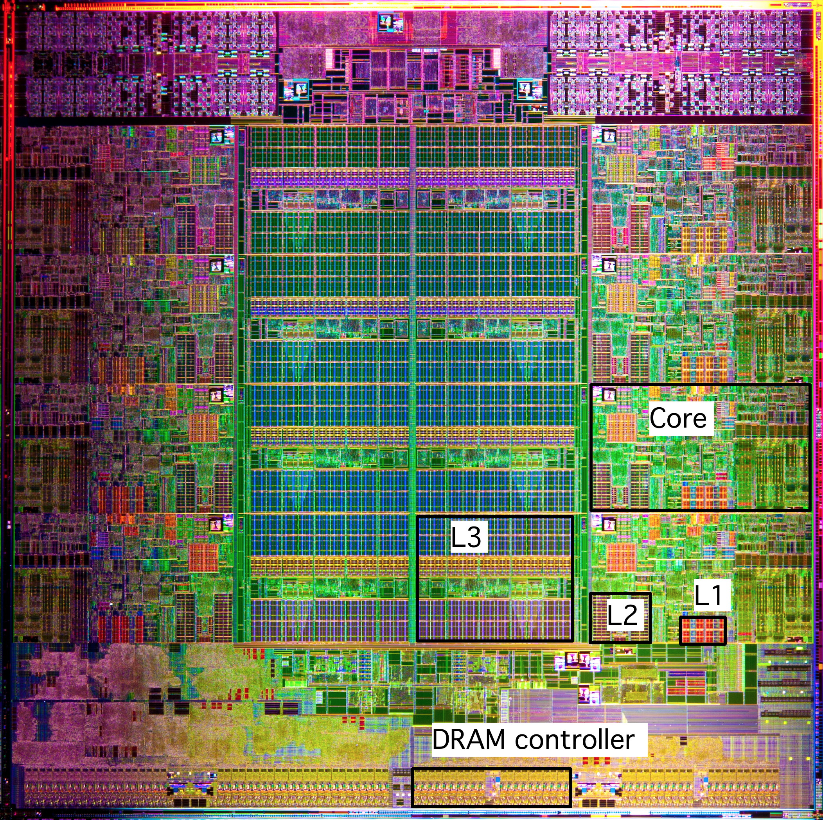
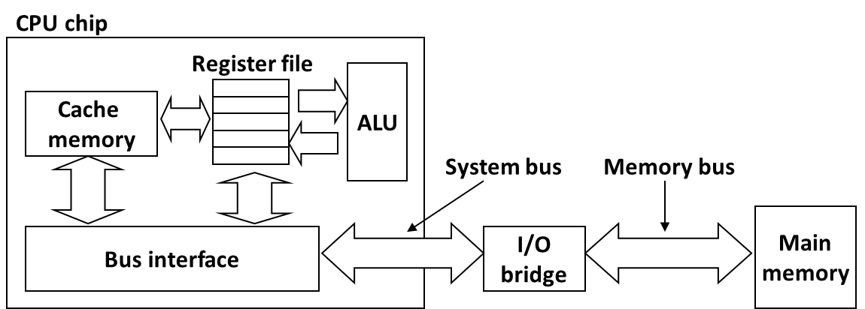
What it Really Looks Like
Intel Sandy Bridge
Processor Die
L1: 32KB Instruction + 32KB Data
L2: 256KB
L3: 3–50MB
[Bryant and O‘Hallaron: CMU] →

Slide 60
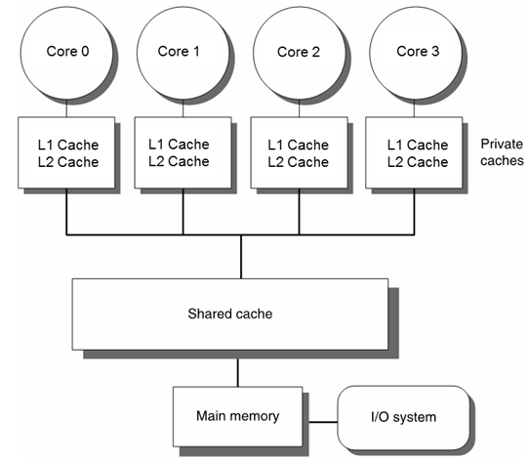
What We Are Interested in: Caches in a Multi-Core Setup
Up to this point, we discussed caches in conjunction with one core
What if there is another core, and this other core changes the memory in a block that you just cached?

Slide 61
Multi-Core Architecture: Two Memory Aspects Coming Into Play
Memory consistency model
Memory coherence
Computer Science at UW-Madison: active in this area
Mark Hill, (Emeritus) David Wood, Karu Sankaralingam, Matt Sinclair
Book on this very topic
PhDs granted on consistency models and/or coherence mechanisms
Topic is deep

Slide 62
Consistency vs. Coherence
Consistency establishes a set of rules that governs the collective actions of the threads relative to the entire system memory
Coherence regards expected behavior that *one* memory location must display relative to transactions carried out by multiple threads running on multiple cores

Slide 63
Consistency vs. Coherence
Earning the attribute of “consistent memory” (for instance “sequential consistency”) imposes a set of stronger/stricter requirements that need to be met compared to what it takes to earn the “coherent memory” attribute
Coherence: with some hand waving, it captures the expectation that if a thread running on core A changes a value in a memory location, other thread running on core B will read the updated value even though the read might occur relatively soon after the change of the value takes place per A’s action
“relatively soon”: a bit of a mystery to me

Slide 64
Cache coherence is a mechanism, a hardware protocol to ensure that memory updates propagate to other cores. Cores will then be able to agree on the values of information stored in memory, as if there were no cache at all
Cache consistency defines a programming model: when do memory writes become visible to other cores?
Defines the ordering of memory updates
A contract between the hardware and the programmer: if we follow the rules, the results of memory operations are guaranteed to be predictable
[Scott B. Baden ]$→$

Slide 65
Caches and Coherency, bottom line
Speeding up sequential computation: done through use of large caches
L1 and L2 cache is per-core
Caching consequence: multiple copies of a physical memory location may exist at different hardware locations
For program correctness, caches must be kept coherent
[Alan Real]→

Slide 66
Caches and Coherency
Coherency operations are usually performed on the cache lines in the level of cache closest to main memory
LLC last level cache: high end systems these days – LLC is Level 3 cache
Significant overhead associated with implementing cache coherence
Two established approaches for enforcing cache coherence
Directory-based
Snooping-based

Slide 67
Cache Coherence Mechanisms: Directory-Based [1/2]
Encountered in systems with large core counts
Example: Intel Xeon Phi 7290 [now discontinued]
Builds on the assumption of that there is a fast point-to-point connection between the cores
Requires a directory indicating which data is stored by which core’s cache
Pros: scales better than the snooping one
Cons: complex, overhead relatively high

Slide 68
Cache Coherence Mechanisms: Directory-Based [2/2]
Directory typically split into pieces, each piece stored by one core
Each mem. transaction needs to consider the possibility of invalidating a cache line in some other core’s cache
Overhead grows, particularly if you have NUMA architectures
One of the main reasons OpenMP doesn’t scale very well
Ultimately, it’s not OpenMP’s fault – it’s an interplay between the underlying hardware and the shared memory model embraced
Threads are heavy
Memory transactions incur overhead

Slide 69
Cache Coherence Mechanisms: Snooping/Sniffing-Based
Encountered in systems with small core counts
Builds on the assumption of a front-side bus; i.e., all memory transactions initiated by any core are processed through one connection/junction to the system memory
Pros: simple
Cons: doesn’t scale
Snooping happens here

